Slide 1
Data
Introduction

Slide 2
About this course
Welcome to the Data Basics course! In this course, we will embark on an exciting journey into the world of data, exploring its fundamental concepts, principles, and practical applications across various domains.
Data has become a ubiquitous and invaluable asset in today's digital age, driving innovation, informing decision-making, and transforming industries and societies. Whether you're a business professional, a researcher, a student, or simply curious about the power of data, this course is designed to provide you with a solid foundation in data literacy and equip you with essential skills to navigate the data-driven landscape with confidence.

Slide 3
Agenda
What is Data?
Why is Data important?
How much Data in our digital world?
Where to store Data?
What is the Usage of Data in real world?
Conclusion

Slide 4

What is Data?

Slide 5
Data
Data refers to raw facts, figures, or information that are collected, stored, and processed by computers.
It can be in various forms, such as
Text
Numbers
Images
Audio
Video
Any other format.
Data is the foundation of all digital information and is typically manipulated and analyzed to extract meaningful insights or to facilitate decision-making. In essence, data is the basic building block of information in the digital age.

Slide 6
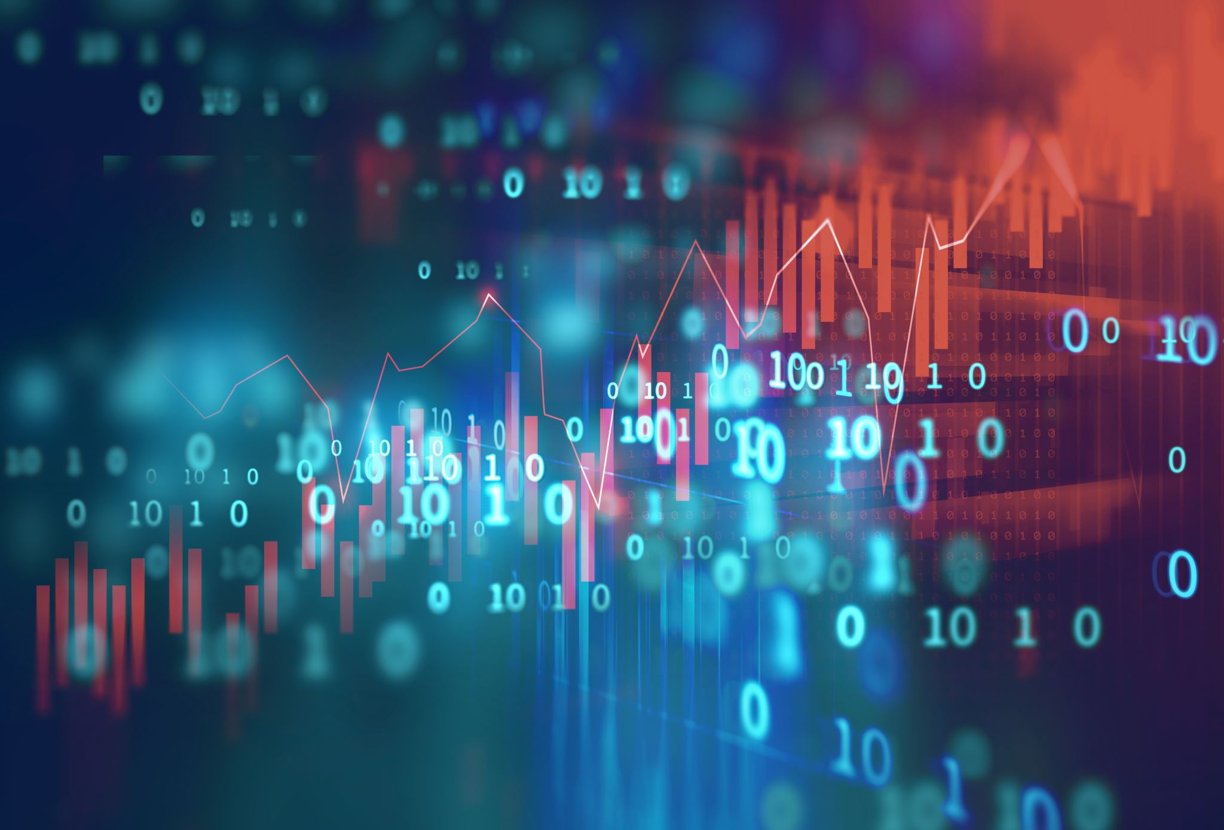
Why is Data important?

Slide 7
Importance of Data
Informed Decision Making: Data provides valuable insights that enable organizations, businesses, and individuals to make informed decisions. By analyzing data, patterns, trends, and correlations can be identified, helping to anticipate market changes, optimize processes, and mitigate risks.
Improved Efficiency and Productivity: Data-driven decision-making can lead to increased efficiency and productivity. By understanding how resources are utilized and where improvements can be made, organizations can streamline operations and allocate resources more effectively.
Innovation and Growth: Data serves as a foundation for innovation and growth. By analyzing data, businesses can identify new opportunities, develop new products or services, and create competitive advantages in the market.
Personalization: Data enables personalized experiences for customers and users. By analyzing user data, businesses can tailor their products, services, and marketing efforts to individual preferences and behaviors, enhancing customer satisfaction and loyalty.
Risk Management: Data analysis allows organizations to identify and mitigate risks. By monitoring and analyzing data related to various aspects of the business, such as financial performance, cybersecurity threats, or market conditions, organizations can proactively address potential risks and vulnerabilities.
Performance Measurement: Data provides a means to measure performance and track progress towards goals. By establishing key performance indicators (KPIs) and analyzing relevant data, organizations can evaluate their performance, identify areas for improvement, and optimize strategies accordingly.

Slide 8

How much Data in our digital world?

Slide 9
Data generating ways
Internet Data: The internet is a major source of data generation, with billions of users creating and consuming vast amounts of data daily through various online activities such as social media, browsing, streaming, and e-commerce.
IoT Devices: The proliferation of Internet of Things (IoT) devices, including sensors, smart appliances, and wearable gadgets, contributes significantly to data generation. These devices collect and transmit data about their surroundings, usage patterns, and environmental conditions.
Enterprise Data: Businesses and organizations generate substantial amounts of data through their operations, including customer transactions, financial records, supply chain information, and more.
Scientific Data: Scientific research, including fields such as genomics, astronomy, climate science, and particle physics, produces vast quantities of data through experiments, simulations, observations, and analyses.
Personal Data: Individuals generate data through various personal activities, such as communication, online interactions, health monitoring, and entertainment consumption.

Slide 10
Amount of Data in our world
IDC's Global Datasphere: IDC's Global Datasphere forecast estimates that the global datasphere will grow to 180 zettabytes in 2025. This includes data created, captured, and replicated across various devices, sensors, and systems.
International Data Corporation (IDC): In 2020, IDC estimated that the total amount of data created and replicated would reach 59 zettabytes by 2020.
Statista: According to Statista, the global data volume was projected to reach 175 zettabytes by 2025.
Cisco Annual Internet Report: Cisco's Annual Internet Report projected that global IP traffic would reach 4.8 zettabytes per year by 2022.
These estimates provide a glimpse into the scale of data generation and consumption globally.

Slide 11

Where to store Data?

Slide 12
Databases
A database is a structured collection of data that is organized and stored electronically in a computer system. It is designed to efficiently manage, retrieve, and manipulate large volumes of data in a structured manner. Databases are essential components of modern information systems and are used in various applications, including business operations, scientific research, e-commerce, and more. Key components of a database include:
Data: The actual information stored in the database, which can include text, numbers, images, audio, video, and other types of data.
Database Management System (DBMS): The software system that enables users to interact with the database. The DBMS provides tools and functions for creating, querying, updating, and managing the database. Examples of popular DBMSs include MySQL, Oracle Database, Microsoft SQL Server, and PostgreSQL.
Tables: Databases organize data into tables, which consist of rows and columns. Each row represents a single record or data entity, while each column represents a specific attribute or field of the data.

Slide 13
Schema: The database schema defines the structure and organization of the data, including the tables, fields, relationships, constraints, and other properties.
Queries: Queries are used to retrieve, manipulate, and analyze data stored in the database. Users can write SQL (Structured Query Language) queries to perform operations such as selecting, inserting, updating, and deleting data.
Indexes: Indexes are data structures used to improve the performance of queries by enabling faster data retrieval. They store a sorted list of keys and pointers to the corresponding data records.
Databases come in various types and architectures, including relational databases, NoSQL databases, object-oriented databases, and more. Each type has its own strengths, weaknesses, and use cases, depending on the specific requirements of the application. Overall, databases play a critical role in managing and leveraging data effectively for organizations and businesses.

Slide 14

What is the usage of Data in real world?

Slide 15
Usage of data in real world
Data plays a crucial role in understanding and addressing various aspects of climate, agriculture, food production, and weather-related phenomena such as rain, heat, and storms. Here's how data is used in each of these areas:
Climate Analysis and Prediction:
Data collected from satellites, weather stations, buoys, and other sources are used to monitor and analyze climate patterns, trends, and changes over time.
Climate models are developed and calibrated using historical climate data to simulate future climate scenarios and predict potential impacts on ecosystems, agriculture, water resources, and human societies.
Data-driven research helps scientists understand the causes and consequences of climate change, including rising temperatures, changing precipitation patterns, sea-level rise, and extreme weather events.
Agriculture and Food Production:
Data-driven agriculture, also known as precision agriculture, involves using data from sensors, drones, satellites, and other sources to optimize farming practices and improve crop yields while minimizing inputs such as water, fertilizer, and pesticides.
Data analytics tools help farmers monitor soil health, moisture levels, temperature, and crop growth in real-time, enabling them to make data-driven decisions about irrigation, fertilization, pest control, and harvest timing.
Weather data and forecasts are integrated into agricultural decision support systems to help farmers anticipate and mitigate the impacts of weather-related risks such as droughts, floods, heatwaves, frosts, and storms on crop production and livestock management.

Slide 16
Rainfall Analysis and Management:
Rainfall data collected from weather stations, radar systems, and satellites are used to monitor precipitation Rainfall data are analyzed to assess drought risk, water availability, and flood potential, as well as to support water resource management, irrigation planning, and flood forecasting efforts.
Rainfall data also play a critical role in climate studies, hydrological modeling, and ecosystem management, helping scientists understand the interactions between precipitation, land surface processes, and atmospheric dynamics.
Heatwaves and Temperature Monitoring:
Temperature patterns, intensity, duration, and distribution over time and space.
data collected from weather stations, satellites, and remote sensing platforms are used to monitor heatwaves, heat stress, and temperature extremes in urban and rural areas.
Heatwave early warning systems use temperature data and heat index calculations to alert authorities and the public to potentially dangerous heat events, allowing for the implementation of heat health interventions and emergency response measures.
Temperature data are also used in climate research, urban planning, public health, energy demand forecasting, and infrastructure design to assess heat-related risks and vulnerabilities and develop strategies for adaptation and resilience.

Slide 17
Conclusion
In conclusion, the Data Introduction course has provided a comprehensive introduction to the fundamental concepts and principles of data. Throughout this course, we have explored the significance of data in today's digital age and its pivotal role in driving decision-making, innovation, and growth across various sectors and industries.
Thank you for participating in the Data Introduction course. We hope that the knowledge and skills gained from this course will empower you to navigate the world of data with confidence and make a positive impact in your endeavors.

